Slide 1
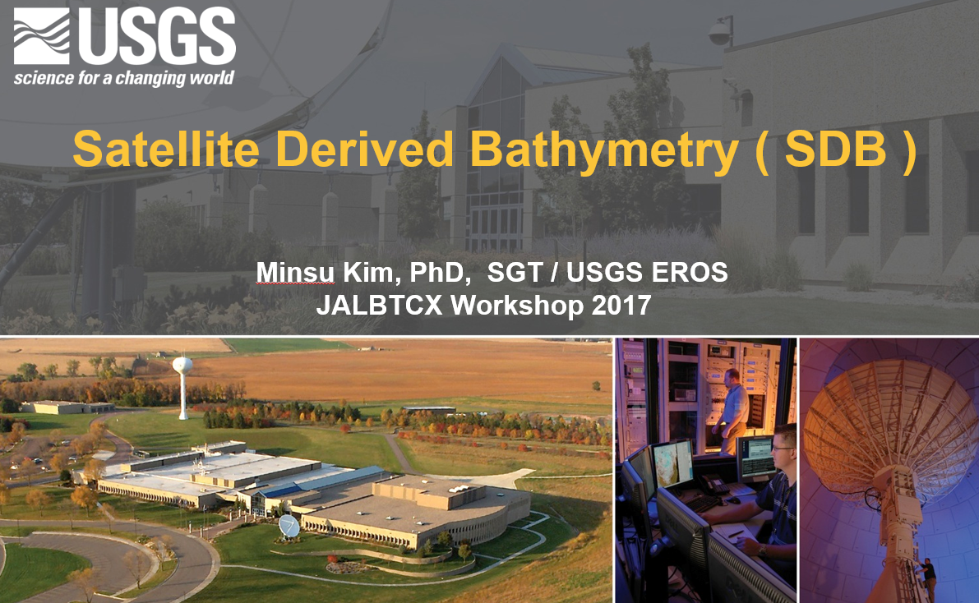

Slide 2
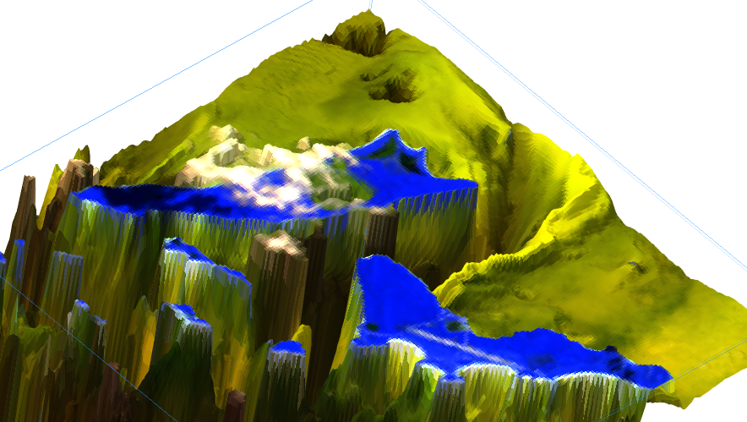
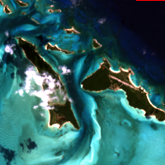


Satellite Derived Bathymetry (SDB )
$$ρ_{toa}={[ρ_{B1}, { ρ}_{B2},{ ρ}_{G},{ ρ}_{R},{ ρ}_{NIR}]}^{T}$$
DEM & bottom reflectance

Slide 3
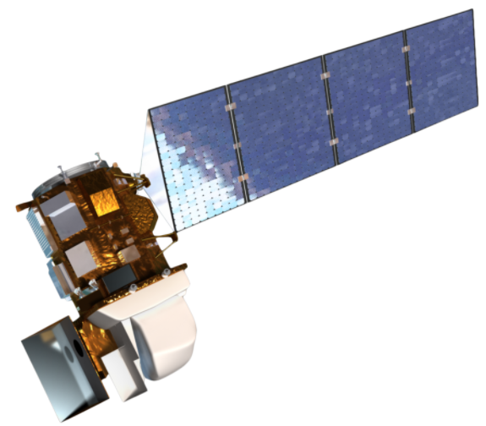

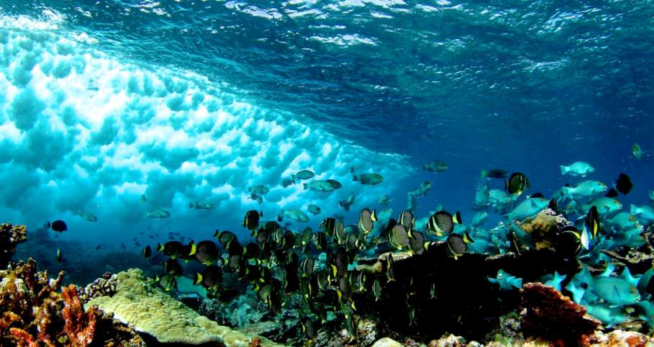

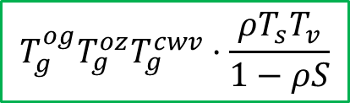



Satellite Derived Bathymetry (SDB )
$$T_{g}^{og}T_{g}^{oz}T_{g}^{cwv}·\{(ρ_{atm}^{int}−ρ_{Ray})∙T_{g,Half}^{cwv}\text{+}ρ_{Ray}\text{\}}/T_{g}^{cwv}$$
Atmospheric
Reflectance
$$ρ_{toa}=ρ_{atm}+ρ_{w}+ρ_{sky}$$
Atmospheric
Correction
$$ρ_{AC}(λ_{0})∙{\left(λ_{0}/λ\right)}^{m}$$
$$T_{g}^{og}T_{g}^{oz}T_{g}^{cwv}·\frac{ρT_{s}T_{v}}{1−ρS}$$
Water-leaving
Reflectance
Sky Reflectance
d
Optical Properties
$$ρ_{∞}\left(1−e^{−2Kd}\right)+ρ_{b}∙e^{−2Kd}$$
Ocean
Optics
ρ_{b}
Solution Method
SDB

Slide 4
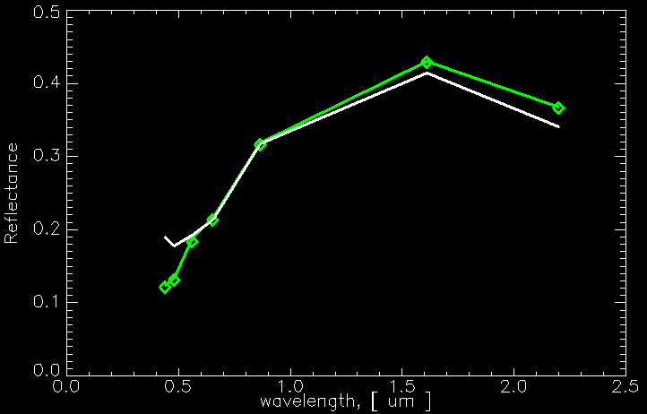
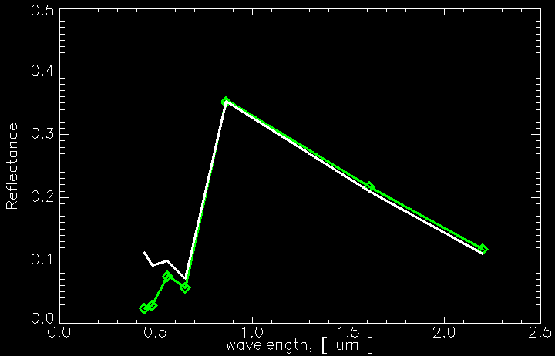
Atmospheric Correction
Soil
ρ_{TOA}
ρ_{TOA}
Atm.
Corr.
ρ
ρ
Vegetation

Slide 5


Atmospheric correction
$$ρ_{ toa}$$
Geometry : θ_{s} , θ_{v} , Δφ
Gas : P , O3 , CWV , CO2 , NOx , O2 , CH4, . . .
Aerosol : τ_{a,550nm} , β (PSD, shape, . . .)
$$ρ$$

Slide 6
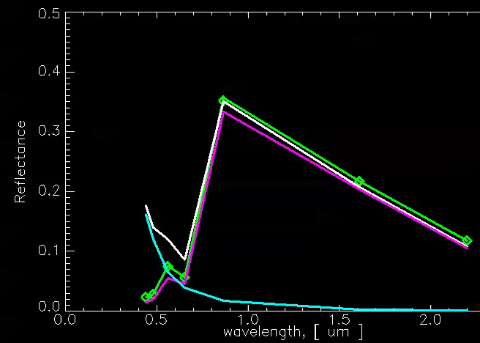
Effect of ( Solar & View ) Zenith Angle

Slide 7
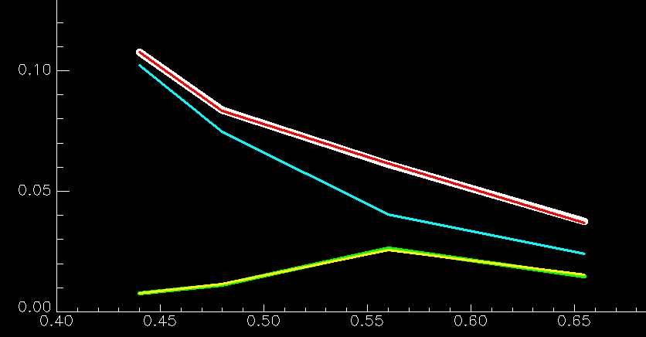

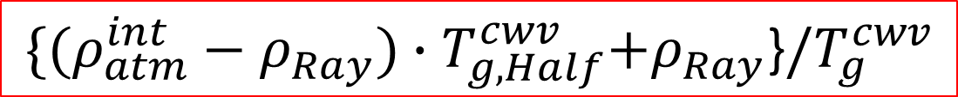

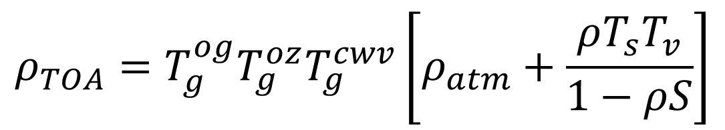





$$ρ_{ toa}$$
USGS EROS developed ( by Dr. Minsu Kim )
Landsat 8 Atmospheric Correction Algorithm
$$ρ_{ atm}$$
$$ρ$$
$$ρ_{ toa}$$
$$ρ_{TOA}=T_{g}^{og}T_{g}^{oz}T_{g}^{cwv}\left[ρ_{atm}+\frac{ρT_{s}T_{v}}{1−ρS}\right]$$
$$ρ_{ atm}$$
$$ρ$$
$$\{(ρ_{atm}^{int}−ρ_{Ray})∙T_{g,Half}^{cwv}\text{+}ρ_{Ray}\text{\}}/T_{g}^{cwv}$$
$$ρ_{atm}$$
: modeling by Rad. Tran. Code 6S (Second Simulation of a Satellite Signal in the Solar Spectrum)

Slide 8
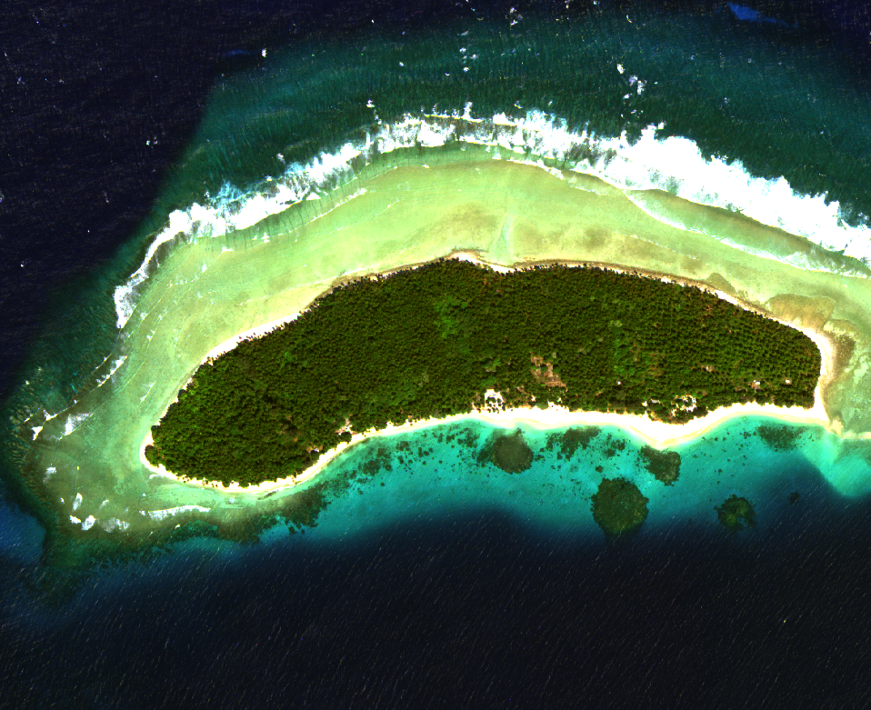

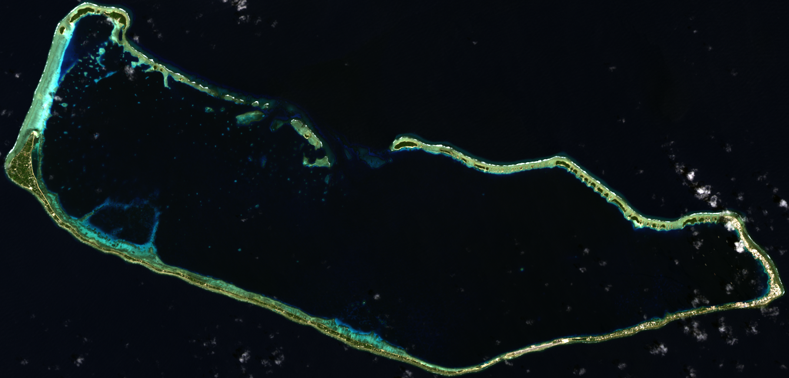
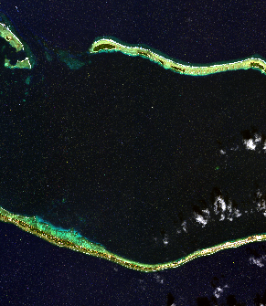
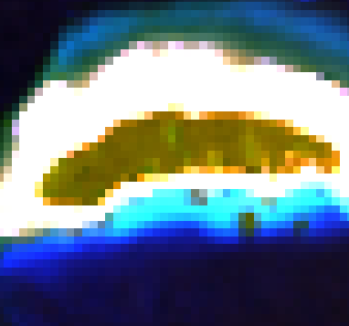
Majuro Atoll, Marshall Islands
Landsat 8 OLI image
WorldView3 (1.6 m)
WorldView3
23 miles
Landsat 8 OLI (30m)

Slide 9
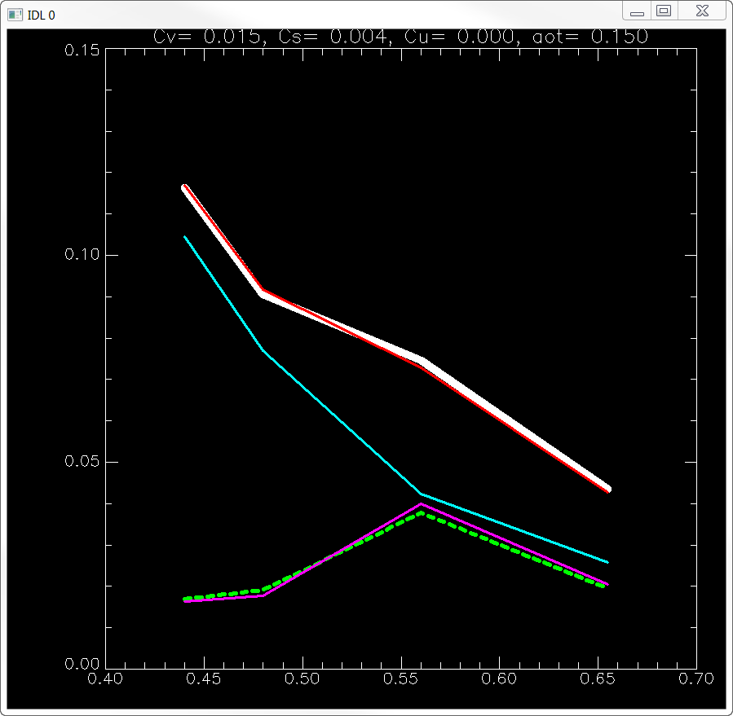
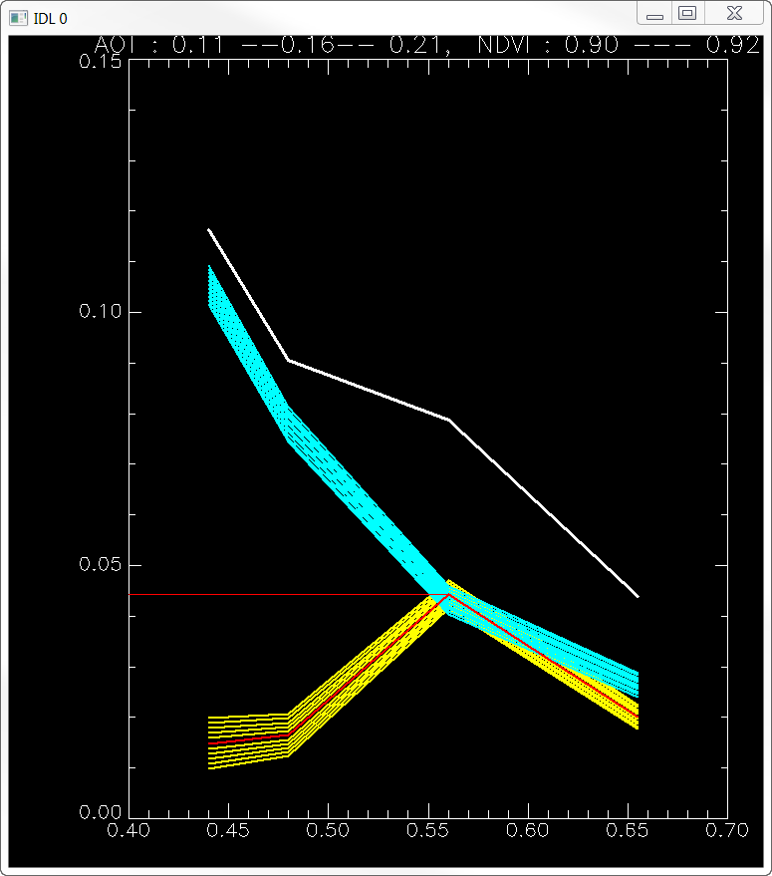
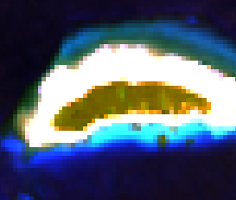



AOT = 0.15
Aerosol inversion ( L8 OLI )
Aerosol Sensitivity
on surface reflectance
$$ρ_{ toa}$$
$$ρ_{ atm}$$
$$ρ_{ veg}$$

Slide 10
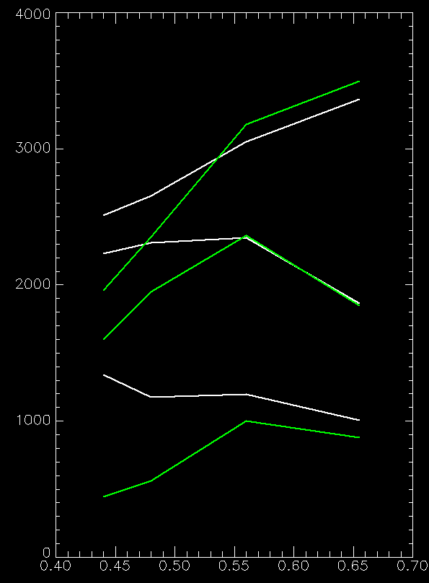
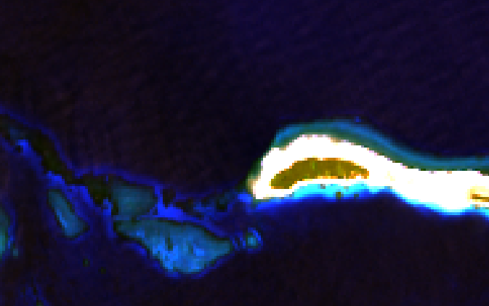
Atmospheric Correction (Landsat 8 OLI)
TOA reflectance
Surface reflectance
2
1
2
3
3
1

Slide 11
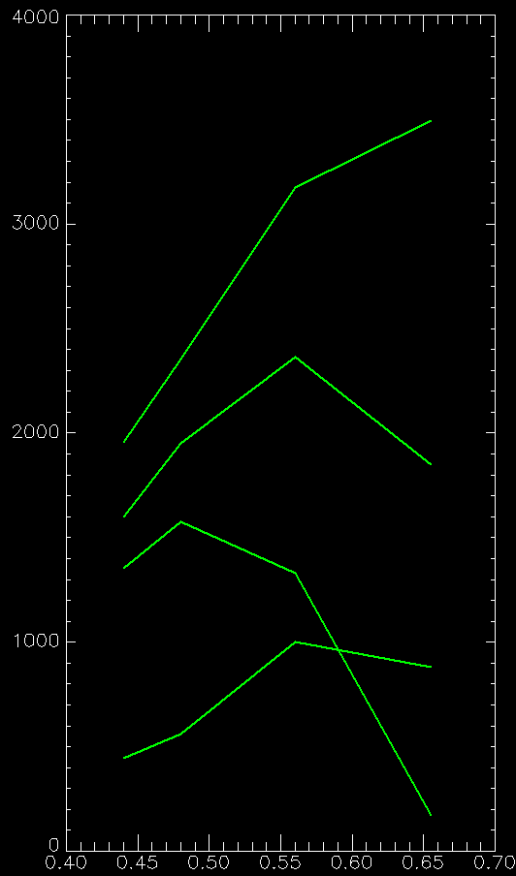
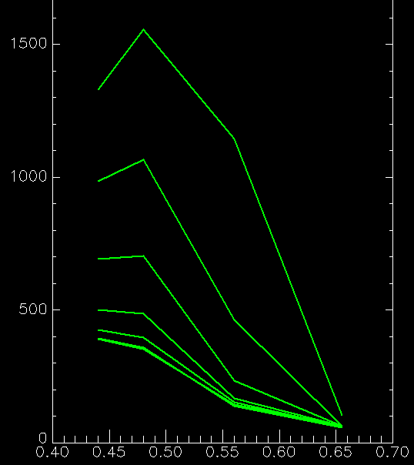
Atmospheric Correction (Landsat 8 OLI)
2
1
2
3
4
3
4
1

Slide 12
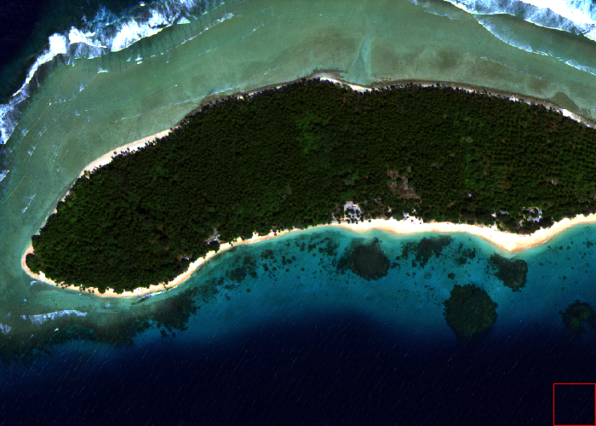
Atmospheric Correction ( WV3 )
( by DigitalGlobe )

Slide 13
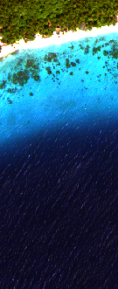
Total Reflectance Spectra
Bottom Reflection component
1 m
2 m
5 m
Atmospheric correction is critical to SDB !
10 m
20 m
Bottom
Reflection
(dashed)
40 m
90 m

Slide 14

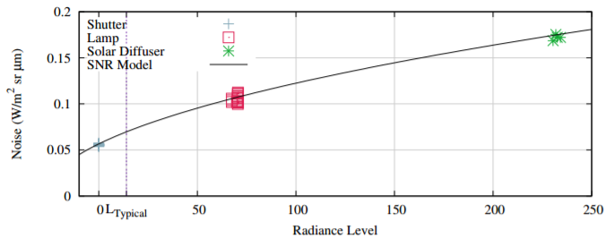


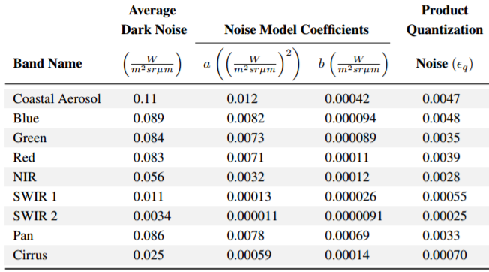
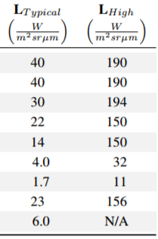
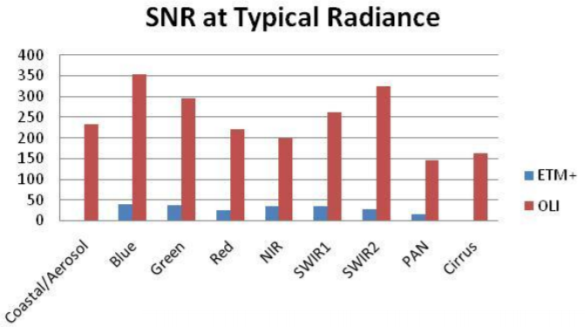
Noise of Landsat 8 OLI (Operational Land Imager)
SNR ≈ L / n_{T}(L)

Slide 16
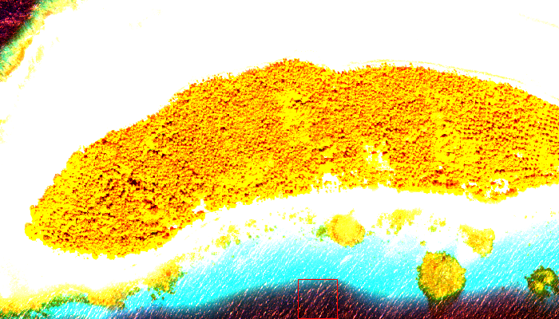
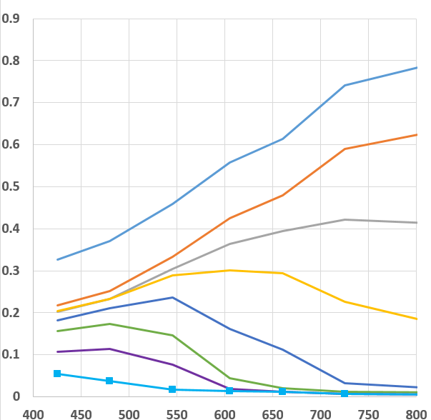
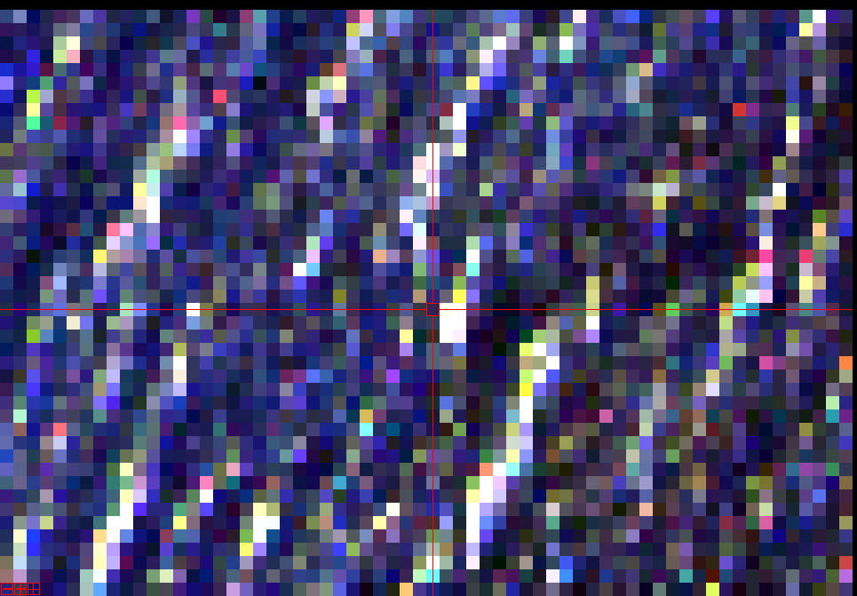
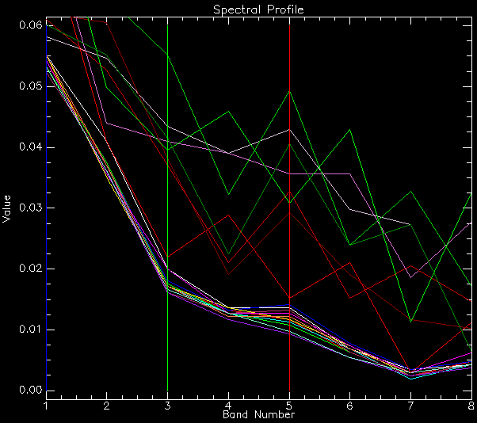
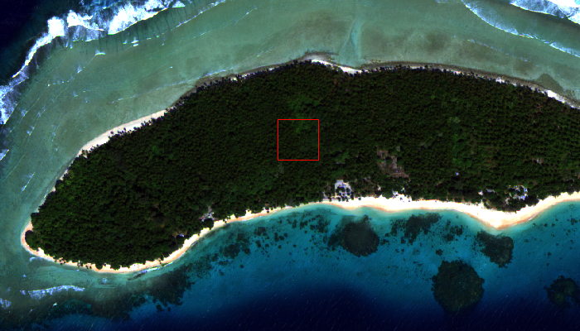
Reflected Sky & Ripples
Unexplained phenomena
Forget about SNR !!!
Real !
Unmodelled noise
σ = 0.02
radiometric stability
σ = 0.002 SNR spec

Slide 17
WV3 Reflectance profile
Atmosphere-corrected
Optically deep water spectrum ⬅ optical constituents
K ≈ a + bb

Slide 18
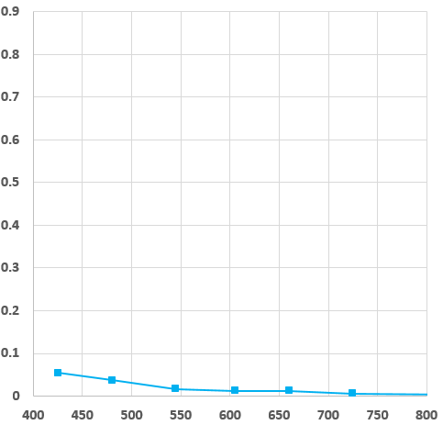



Water reflectance equation
Water volume-backscattering bottom-reflection sky-reflection
0
0
$$ρ_{AC}\left(d\right)=ρ_{∞}∙\left(1−e^{−2Kd}\right)+ρ_{b}∙e^{−2Kd}+ρ_{sky}$$
$$∞$$
$$∞$$
$$∞$$
Optically deep
$$ρ_{AC}\left(∞\right)=ρ_{∞}+ρ_{sky}$$
Infinitely deep water (Atmospherically corrected)

Slide 19

Analysis of deep water spectrum
Atmosphere-corrected
Worldview 3 reflectance
NL-Optimization
Attenuation
( K ≈ a + bb ) / 10
Constrained L-M
(parameter-bounding)
Water
reflectance
(volume-
backscattered)
Sky reflectance
← Diff = Satellite - Model
$$ρ_{AC}≈ρ_{∞}+ρ_{sky}$$

Slide 20
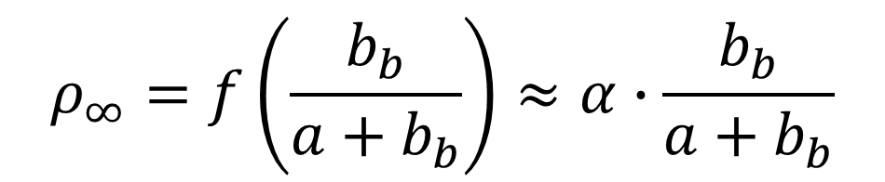
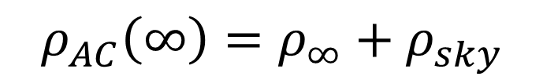
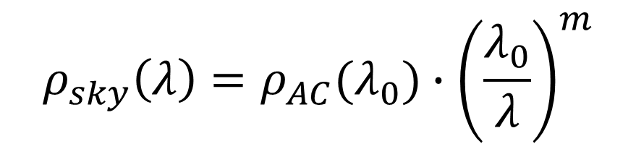
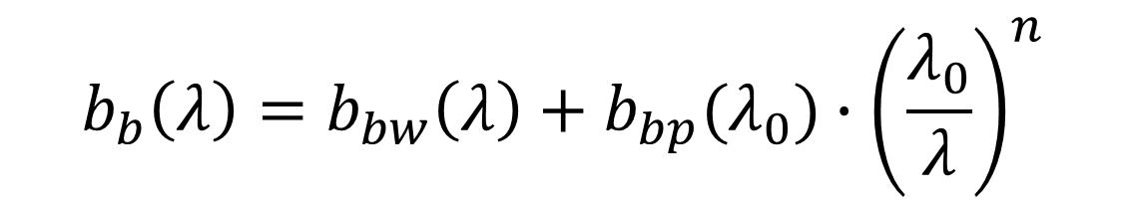
$$ρ_{AC}\left(∞\right)=ρ_{∞}+ρ_{sky}$$
Optically deep water spectrum ⬅ optical constituents
K ≈ a + bb
$$ρ_{∞}=f\left(\frac{b_{b}}{a+b_{b}}\right)≈α∙\frac{b_{b}}{a+b_{b}}$$
$$b_{b}\left(λ\right)=b_{bw}\left(λ\right)+b_{bp}(λ_{0})∙{\left(\frac{λ_{0}}{λ}\right)}^{n}$$
$$a\left(λ\right)=a_{w}\left(λ\right)+CHL∙Φ^{∗}\left(λ\right)+a_{cdom}\left(λ_{0}\right)∙exp⁡[−S(λ−λ_{0})]$$
$$ρ_{sky}\left(λ\right)=ρ_{AC}(λ_{0})∙{\left(\frac{λ_{0}}{λ}\right)}^{m}$$

Slide 21
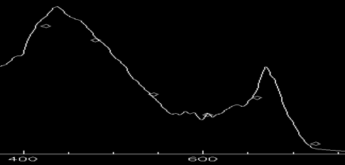
Total Attenuation
K(λ)
Chlorophyll absorption

Slide 22
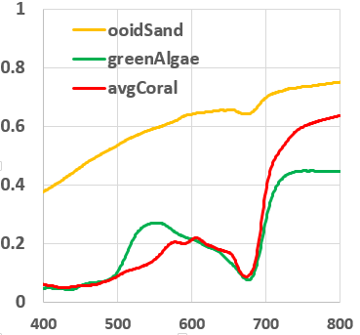

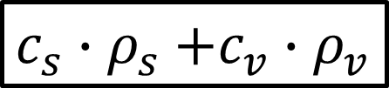

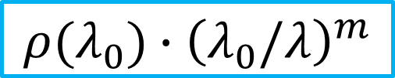
Depth & bottom solution via optimization
1
$$ρ \left(d\right)=ρ_{∞}\left(1−e^{−2Kd}\right)+ρ_{b}∙e^{−2Kd}+ρ_{sky}$$
$$ρ_{s}$$
$c_{s}∙ρ_{s}$ $+c_{v}∙ρ_{v}$
$$ρ(λ_{0})∙{\left(λ_{0}/λ\right)}^{m}$$
$$ρ_{v}$$
2
3
4
4 unknowns ➔ Inversion using nonlinear-optimization

Slide 23
Depth Inversion Example
OLI data → depth = 4.75 m
WV3 data → depth = 5.88 m

Slide 24



SDB summary
$$ρ_{toa}=ρ_{atm}+ρ_{w}+ρ_{sky}$$
$$ρ_{toa}=T_{g}^{og}T_{g}^{oz}T_{g}^{cwv}·\{(ρ_{atm}^{int}−ρ_{Ray})∙T_{g,Half}^{cwv}\text{+}ρ_{Ray}\text{\}}/T_{g}^{cwv}+T_{g}^{og}T_{g}^{oz}T_{g}^{cwv}·\frac{ρT_{s}T_{v}}{1−ρS}+ρ_{AC}(λ_{0})∙{\left(λ_{0}/λ\right)}^{m}$$
Atmospheric Correction
$$ρ +ρ_{sky}$$
$$=ρ_{∞}\left(1−e^{−2Kd}\right)+ρ_{b}∙e^{−2Kd}+ρ_{AC}(λ_{0})∙{\left(λ_{0}/λ\right)}^{m}$$
$$ρ_{∞}$$
Estimate K (λ)
Find in the image
NL-Optimization
Pixel – by – Pixel
NL-Optimization
SDB
, Bottom reflectance, Sky reflection

Slide 25
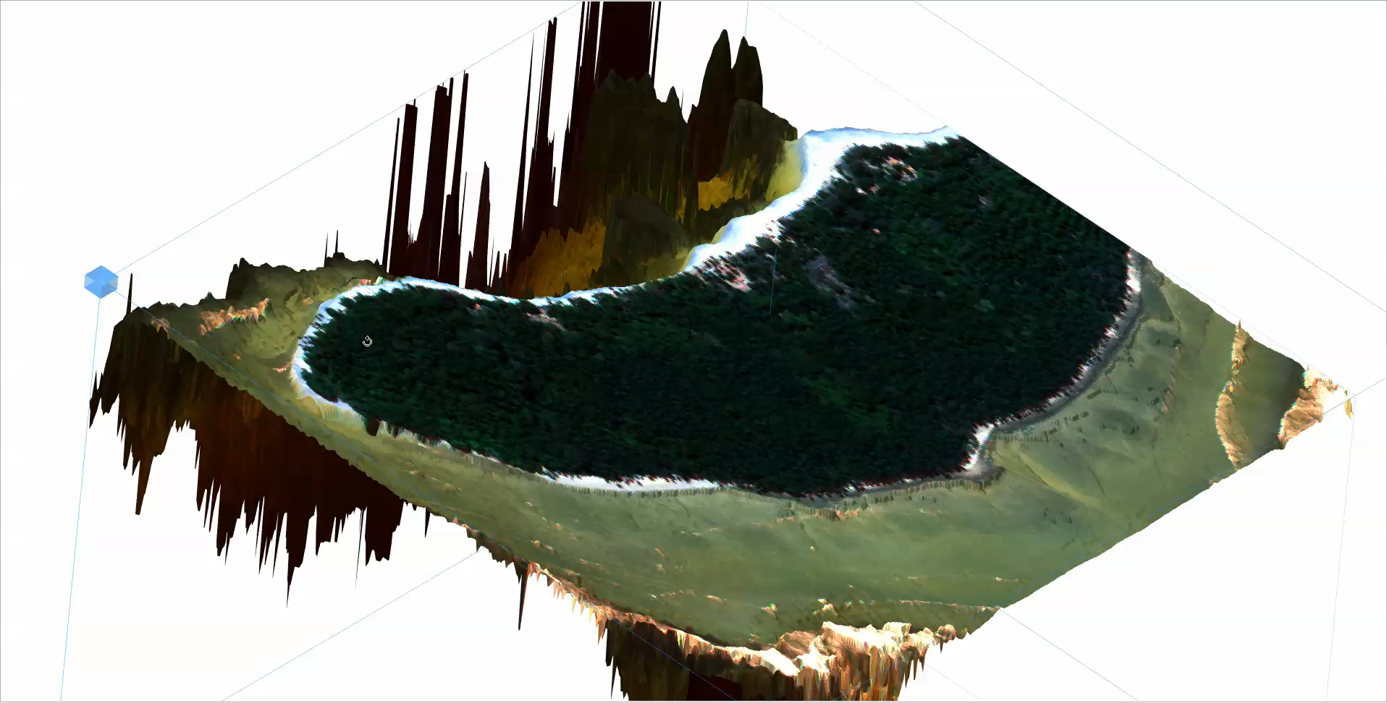
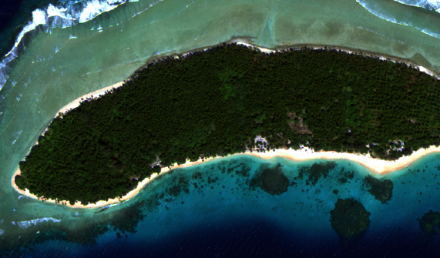
Majuro Atoll
Marshall Islands
WorldView3

Slide 26
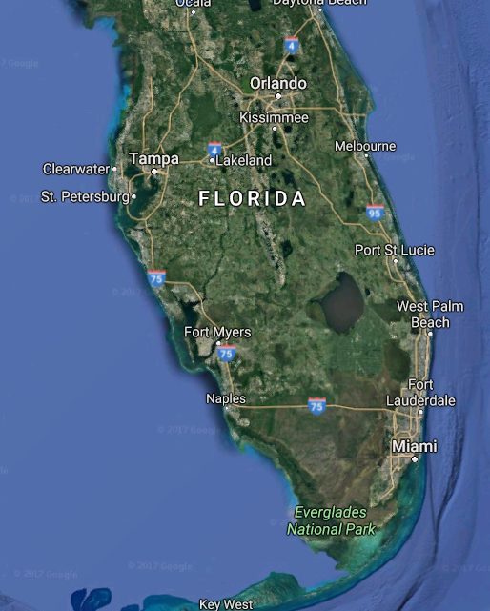
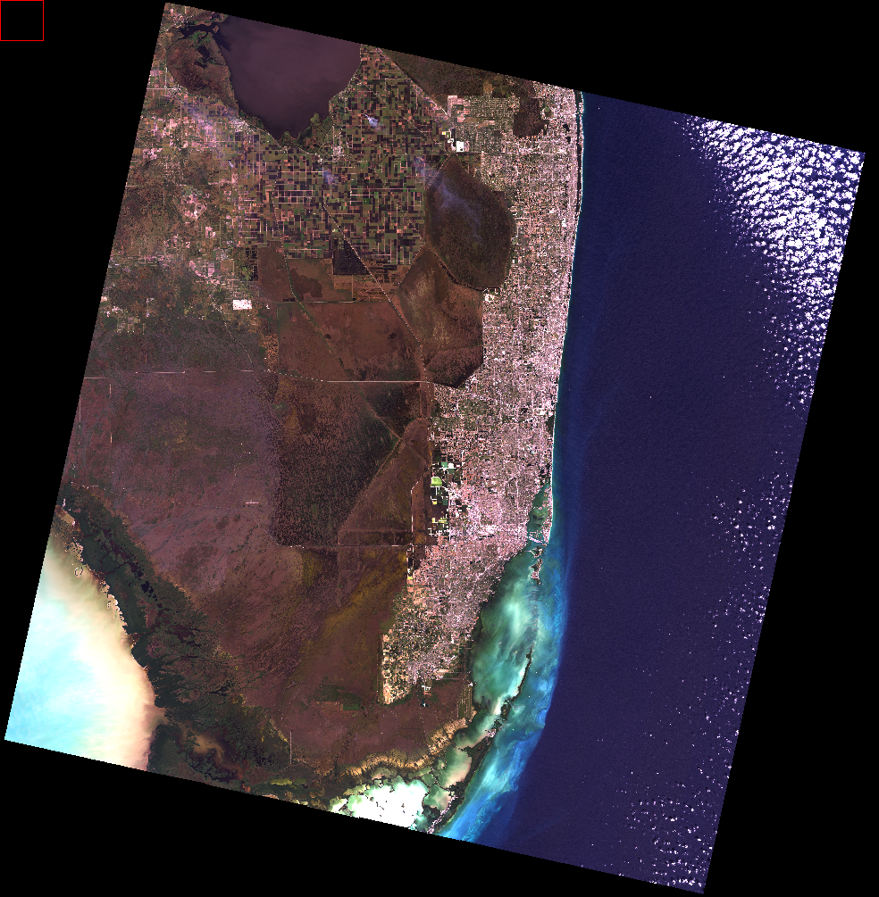
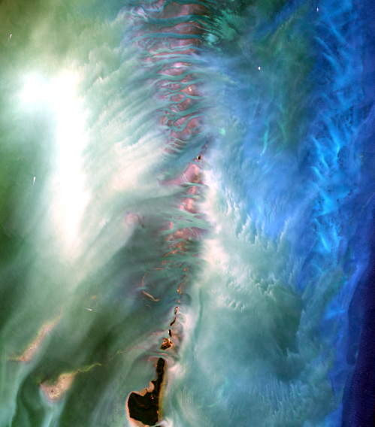
Biscayne Bay, Miami, FL

Slide 27
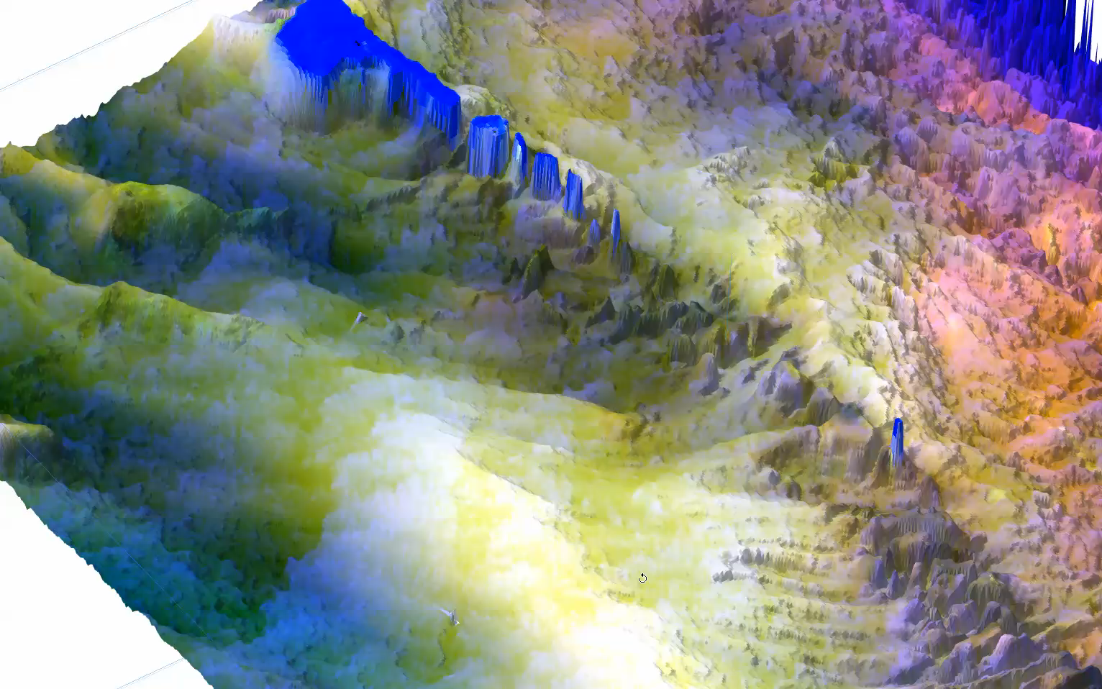

Slide 28



200 km x 200 km

Slide 29

Landsat 8 OLI

Slide 30



